Slide 1
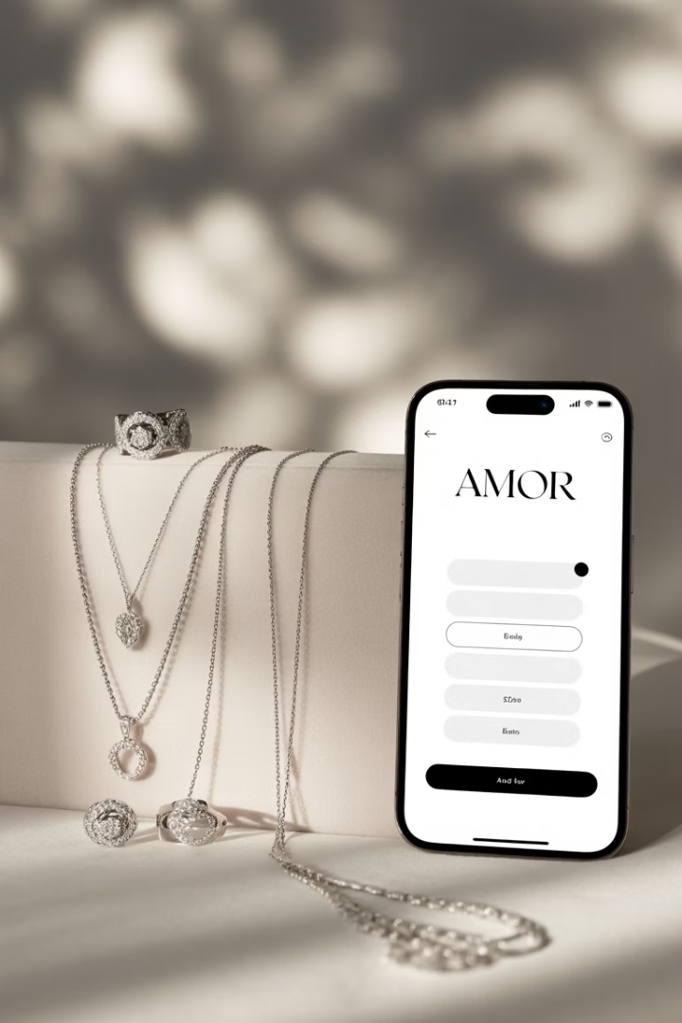
Amor: Reinventing Jewelry Discovery Through AI
Swipe-Based Shopping Meets Smart Recommendations
Presented by: Amit Cohen | Roey Fabian | Dvir Chitrit

Slide 2

Agenda
Business Problem & Product Vision
Solution Overview
What are the market needs
How Amor works
Dataset & Preprocessing
Implementation & Clustering
Technical foundation
Building the recommendation engine

Slide 3
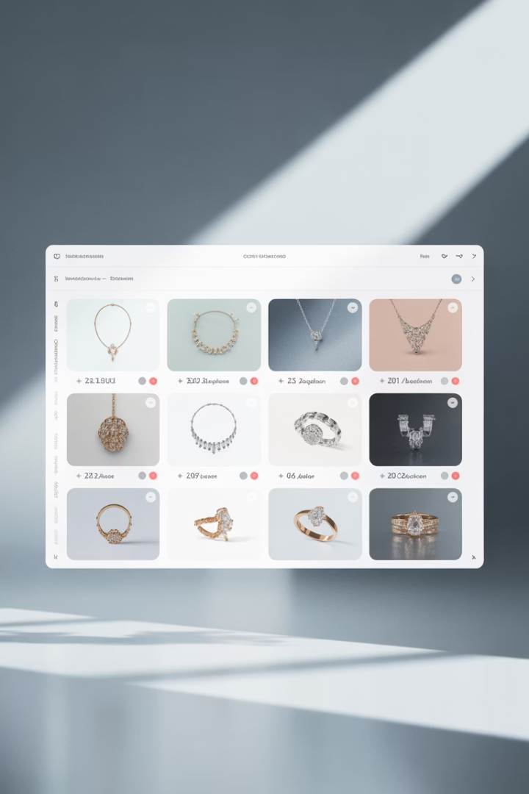
Problem for Users and Brands
For Consumers
For Small Brands
Discovery is uninspired
Exposure is expensive
No reward for browsing
Ads are high risk
Lacks personalization
No feedback loop

Slide 4
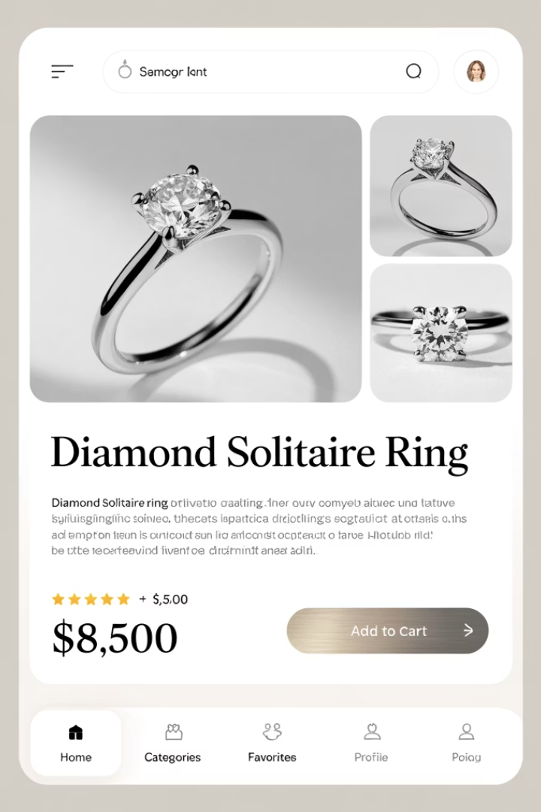



Introducing Amor
AI-powered swipe-based jewelry discovery app
Tinder meets Pinterest meets Shopify
Rate Low
No thanks
Rate High
I like this!
Double Tap
Save to wishlist

Slide 5
The Product Vision
Jewelry Discovery
Personalized Recommendations
Rewards
User experience people want
Users receive cashback
Learning user preferences over time

Slide 6
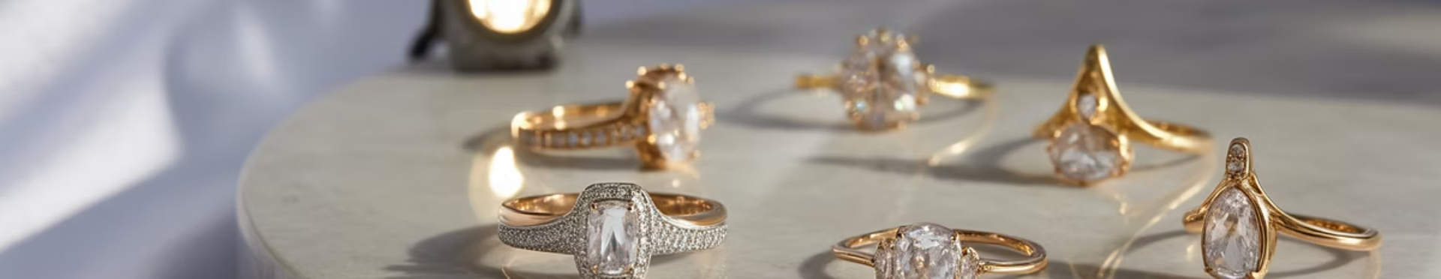
Strategic Entry: Jewelry First
High Margins
Highly Visual
10-20% affiliate commissions
Design oriented
Easy Onboarding
Engaged Users
Instagram images ready to use
Young women already browsing for fun

Slide 7
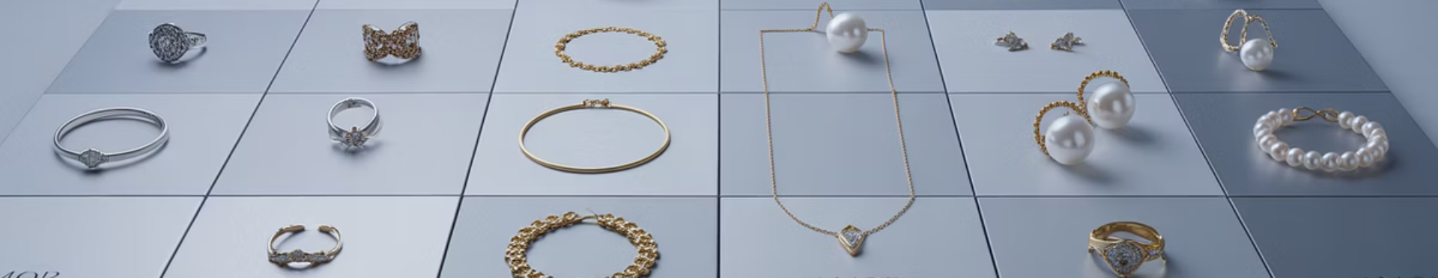
The Dataset
17,000+
—
dataset_jewellery1
Images
Labels
Source
Jewelry product photos
No predefined categories
ayesha111 (HuggingFace)
Problem: No structure for learning

Slide 8

What is CLIP?
A multimodal model that connects images and text in a shared vector space
Creates numerical representations of both images and text
Understands semantic relationships without supervision
Enables cross-modal comparison between images and words

Slide 9

How does CLIP Work?
Pairing Images with Matching Text Descriptions
Image Encoder
Text Encoder
Similarity Computation
Contrastive Loss
Vision Transformer
Uses Transformer
Cosine similarity between the image and text vectors
Optimizes by image–text pairs
Image to 512-dimensional vector
Text to 512-dimensional vector

Slide 10

What Was CLIP Trained On?
Massive Dataset
Diverse Domains
Why It Matters
400 million image-text pairs
A spectrum of visual culture
Robust visual understanding
Web images with captions
Art and illustrations
Generalizes across domains
Article illustrations
Product photography
No task-specific fine-tuning
Social media content
Fashion and lifestyle

Slide 11
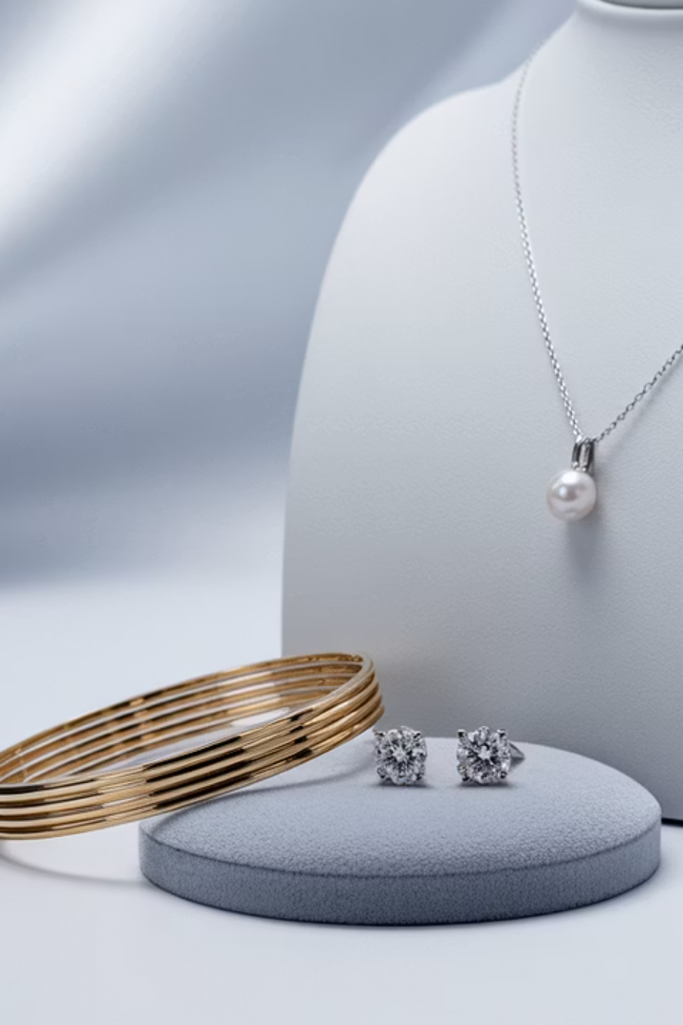




Why Amor Uses CLIP
Works Out-of-the-Box
No labels needed - MVP
Captures Semantic Features
Color, shape, elegance
Well-Supported
PyTorch + Pandas Integration
Lightweight
Efficient for 17k images

Slide 12

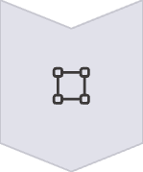
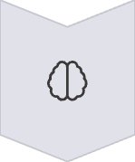

How We Use CLIP
Image Input
Processes images through model (no additional training)
Vector Creation
Generates 512-dimensional embedding
Semantic Understanding
Understands visual concepts
Ready for Clustering
Creates foundation for our jewelry recommendation system

Slide 13
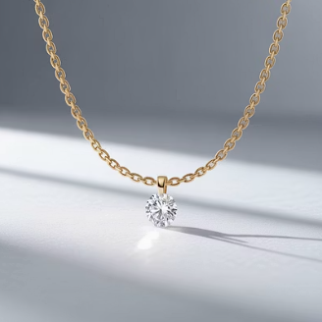
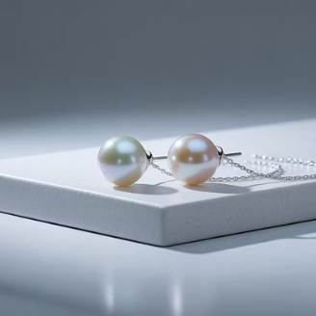

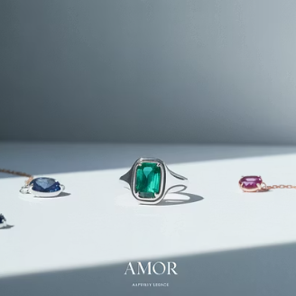
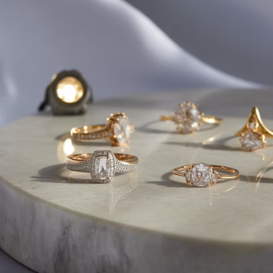
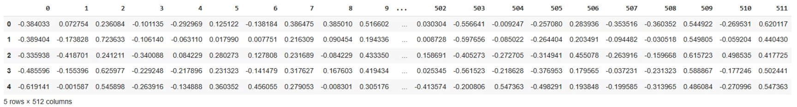
Result: Our Embedding Space
17,375 images mapped to 512D feature vectors
5 rows x 512 columns

Slide 14
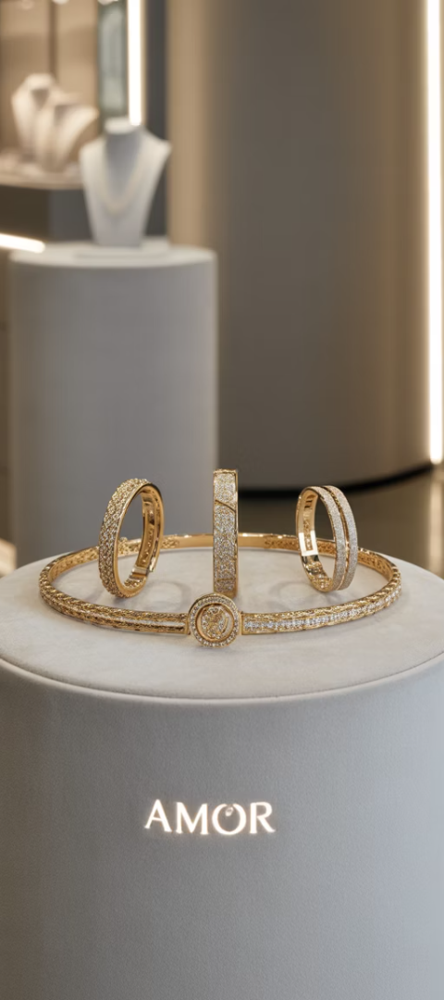
Why Cluster?
Unsupervised Organization
Cold Start Recommendation
Group similar jewelry items
Rate items to discover similar pieces
Cluster 1: Chunky gold bracelets
Cluster 2: Minimalist rings

Slide 15
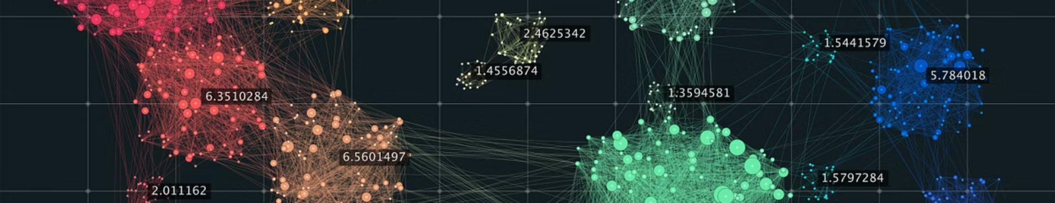
What is DEPICT?
Deep Clustering Approach
Key Advantages
Unsupervised learning algorithm
Handles visual relationships
Optimized for high-dimensional embeddings
Discovers natural groupings
Works with CLIP embeddings

Slide 16
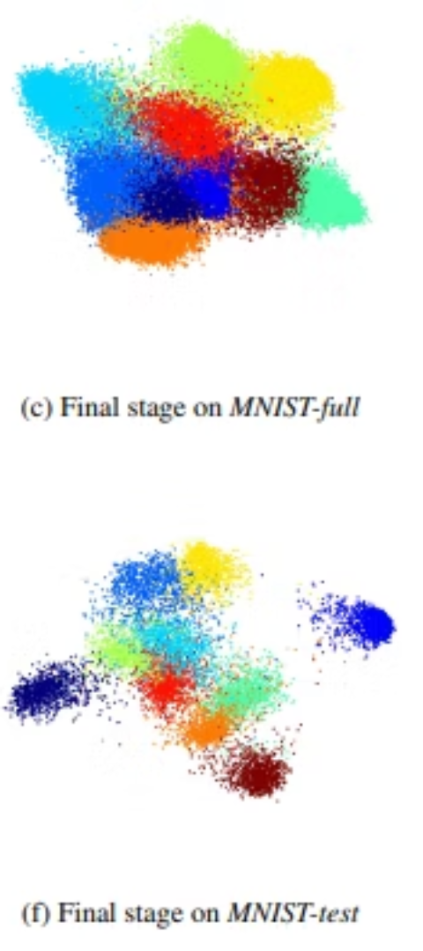




DEPICT Architecture Overview
Autoencoder
Compresses embeddings to latent space
Clustering Layer
Assigns soft cluster probabilities
KL-Divergence Regularization
Ensures cluster confidence
Reconstruction Loss
Preserves input integrity

Slide 17
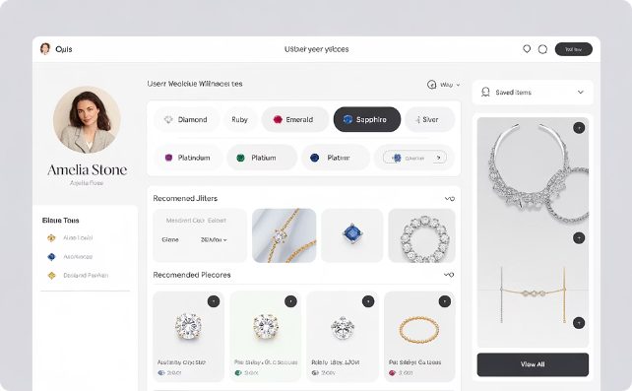
Building a Recommendation Engine
Cluster Matching
User preferences mapped to top jewelry clusters
Created through onboarding quiz and rating behavior

Slide 18
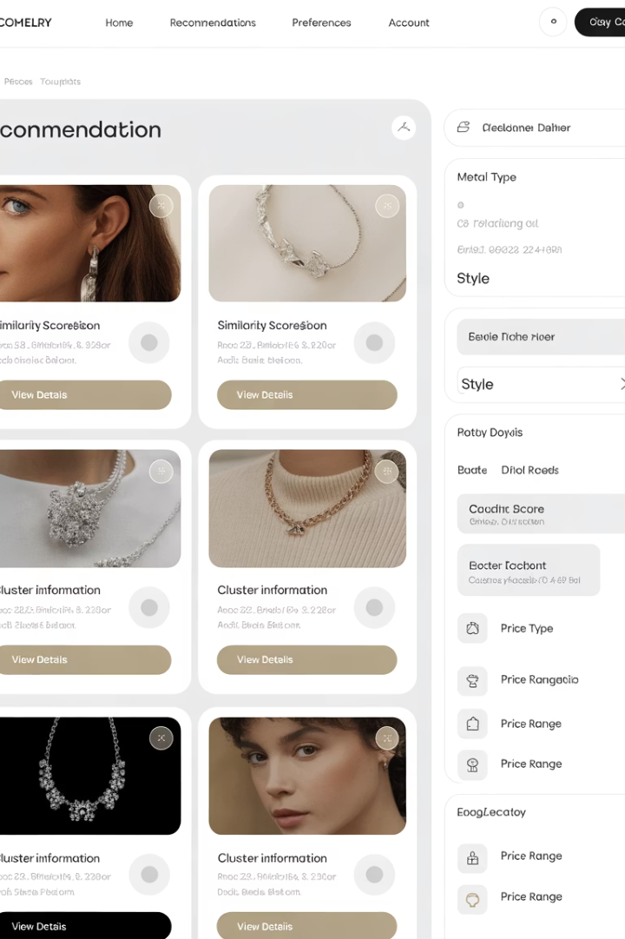
Recommender System Output
System recommends images based on cluster scores
User Rates 5 Items Across Clusters
Item
Score
Cluster
Gold Ring
3
2
Pearl Earrings
2
1
Silver Bracelet
5
3
Diamond Pendant
1
2
Gemstone Ring
4
4

Slide 19
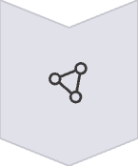



Toward Personalization in Amor
Cluster-Based
Current approach
User-Based
Style profiling
Continuous Refinement
Based on ratings
Style Communities
Match similar users

